Slide 1



Seattle real estate
An investigation into market dynamics

Slide 2
Brief
Data
Core Questions
Roadblocks
Results
Property Sales
May 2014-
May 2015
Feature distribution?
Best features for predicting price?
What makes a property valueable?
Multicollinearity among data set
Data imbalance
Best feature for price prediction
Linear regression model
What makes a property valuable?
22k properties
21 features
1/2 of data describing size
Actionable insights

Slide 3
Best predictors for price
Size
Grade
Workflow:
Data Cleaning/wrangling
Dropping columns
Normalization/transforming
Split data in train/test set
Results:
Linear regression score: 0.6 (60% accuracy)
Gradient boosted regression: 0.8 (80% accuracy
Bath
rooms
VIEW

Slide 4


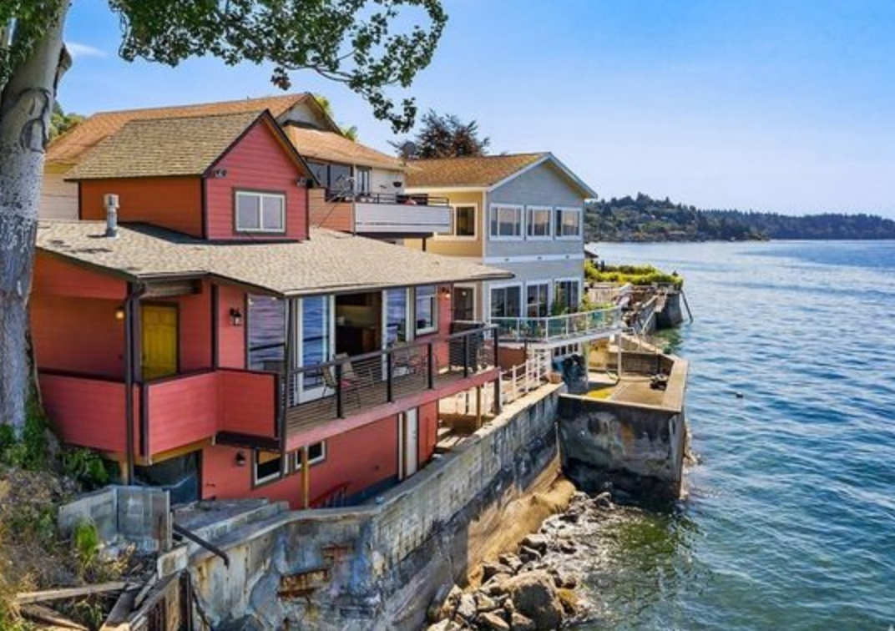

Exploration
How do our sold properties look like
Bedrooms
Bathrooms
Waterfront
Location
Average price >650k
in just 24%
of zip codes
72% w/
3 or 4 =
85% w/
1 or 2
1million $
average difference

Slide 5
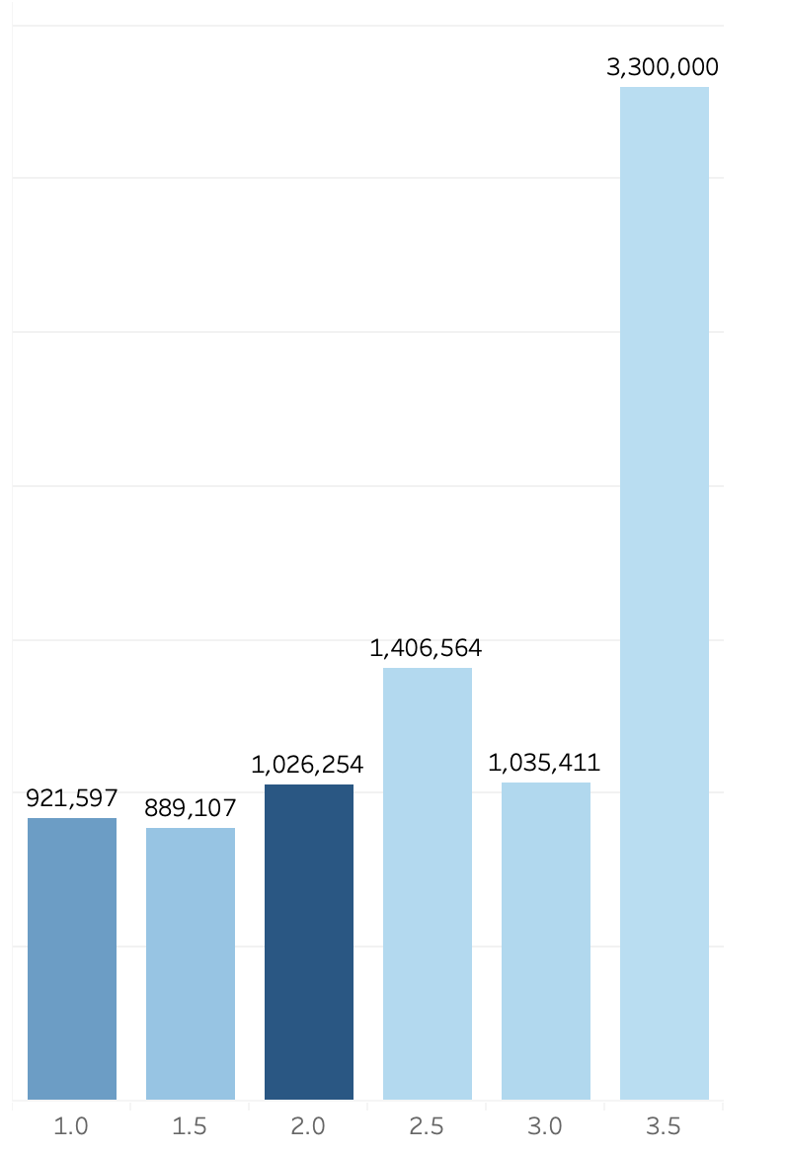
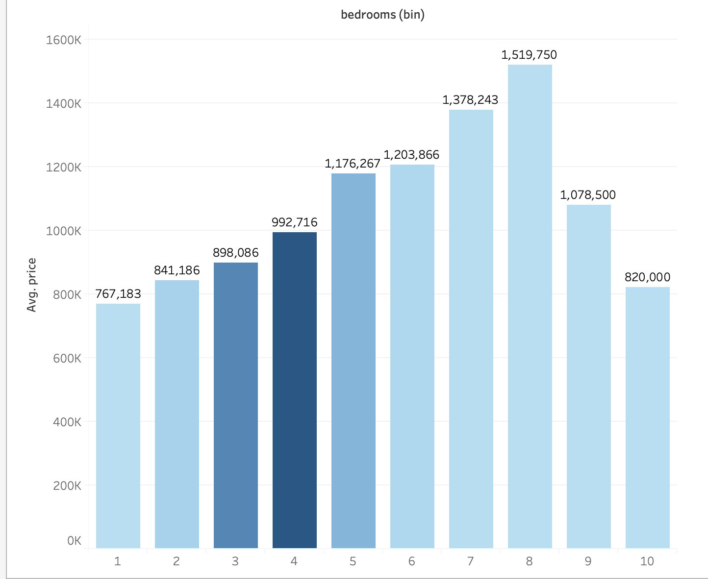
>650k
View
Bedrooms

